Slide 1
CSE 445 Lecture 1
Machine Learning Intro

Slide 2
Course Name & Class Time
Course Name: Machine Learning – (CSE445)
An undergraduate-level course – supposed to be more conceptual than theory
2 lectures every week (3 hours)
6-8 hours study in total

Slide 3
Workload and Grading Policy
3 class tests (theory + programming) worth 15%
Theory part: Why does it work?
Practical part: Usage of ML algos, analysis of results, metrics
Best 1 out of 2
Project worth 20%
Pick a project based on your works/idea – not from blogs/kaggle/etc.
Programming part: Implement/use ML algos, analysis of results
Must submit a power point presentation & a paper format report
Questions will be asked during the presentation
Mid & Final exams worth 60%
Mid & Final will be worth 30% each (total 60%)
They will have 3/4 questions (no choice – must answer all)
Questions will be part theory part practical concepts
Attendance – 5%

Slide 4
Reference materials
Course slides and notebooks will be sourced from previous iterations of this course and relevant slides/materials from me/other researchers/blogs
No fixed textbook
But you can read these free books
https://github.com/udlbook/udlbook/releases/download/v5.0.3/UnderstandingDeepLearning_02_09_26_C.pdf
probml.github.io/pml-book/book1.html
probml.github.io/pml-book/book2.html
Different books vary in terms of
Set of topics covered
Flavour (e.g., classical statistics, deep learning, probabilistic/Bayesian, theory)
Terminology and notation (beware of this especially)

Slide 5
Course Goals..
Learning the basic principles (computer science + statistics + maths + tricks) used in Machine Learning
Make sense of the applied math models used in machine learning
Apply ML models using hardware/data constraints
Focus on developing the ability to
Work on ML projects at jobs/research
Being able to find computational complexities of different ML methods
Evaluate alternate solutions
Being able to understand the training complexities and the tweaks

Slide 6
Course Outlines
Module | Classes | Main Topics
Foundations | 4/5 Lectures | What is ML, Linear Algebra, data set, loss, evaluation, nearest neighbors
Linear Models | 4/5 Lectures | Linear regression, logistic regression, SVM, Perceptron, Neural Networks
Statistics & Metrics | 3 Lectures | Bias-variance, Metrics, Model Selection, Regularization
Trees & Ensembles | 4/5 Lectures | Decision trees, random forest, gradient boosting
Unsupervised Learning | 3/4 Lectures | Clustering, PCA, SVD
Reinforcement Learning & Wrap-up | 1 Lecture | RL basics, course synthesis
Exams | 2/3 Classes | Quiz/Mid

Slide 7
What is Machine Learning
We are living in an age where data comes in abundance, we want to turn this data into knowledge
Machine Learning is a field of computer science/statistics/applied mathematics
It tries to make sense of data
Machine learning is an area of artificial intelligence that fits mathematical models to observed data
It uses tools from mathematical disciplines such as probability, statistics, and optimization theory to extract patterns from data
The main idea behind machine learning is learning from examples
We prepare a dataset with examples, and a machine learning system “learns” from this dataset
In other words, we give the system the input and the desired output, and the system tries to figure out how to do the conversion automatically, without asking a human

Slide 8
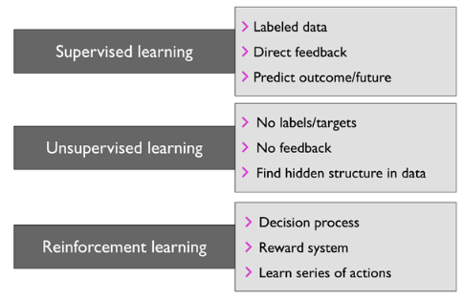
Types of machine learning systems

Slide 9
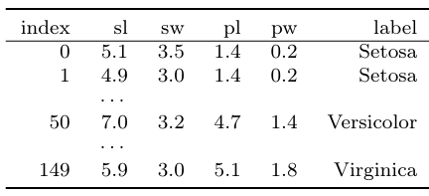
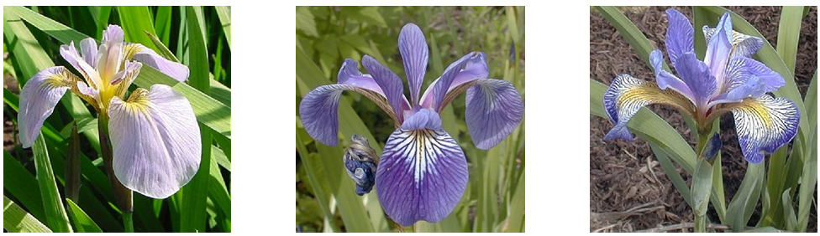
Supervised learning
In supervised learning, the training data we feed to the algorithm includes the desired solutions, called labels
The inputs (columns) are called the features covariates, or predictors
This is often a fixed-dimensional vector of numbers, such as the height and weight of a person, or the pixels in an image

Slide 10
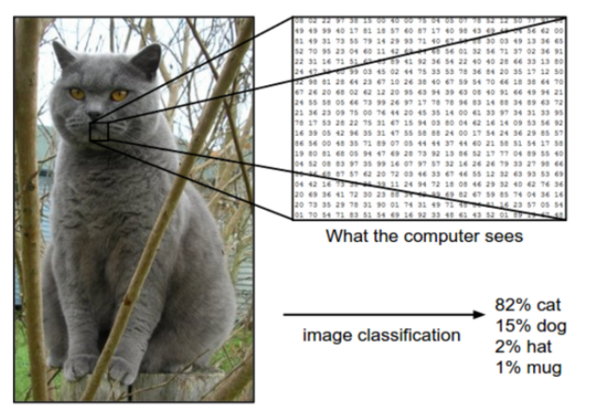
Supervised learning - Classification
In classification problems, the output space is a set of C unordered and mutually exclusive labels known as classes, Y = {1, 2, . . . , C}.
The problem of predicting the class label given an input is also called pattern recognition. (If there are just two classes, often denoted by y ∈ {0, 1} or y ∈ {−1, +1}, it is called binary classification.

Slide 11
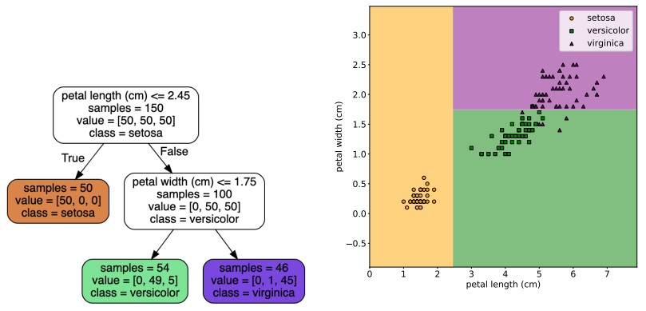
Supervised Learning – Feature Modeling

Slide 12
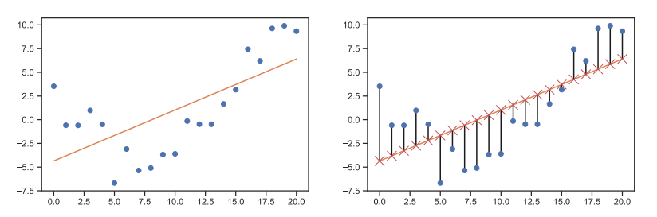
Supervised learning – Regression
Suppose we want to predict a real-valued quantity y Є R instead of a class label y Є {1, … … …,C} ; this is known as regression.

Slide 13
Supervised learning algorithms
Here are some of the supervised learning algorithms
Linear Regression
Logistic Regression
Support Vector Machines (SVMs)
Decision Trees and Random Forests
Neural networks

Slide 14
Unsupervised Learning
In supervised learning, we assume that each input example x in the training set has an associated set of output targets y
Our goal is to learn the input-output mapping.
A more interesting task is to try to “make sense of” data
As opposed to just learning a mapping.
That is, we just get observed “inputs” D = {x_{n} : n = 1 : N} without any corresponding “outputs” y_{n}.

Slide 15
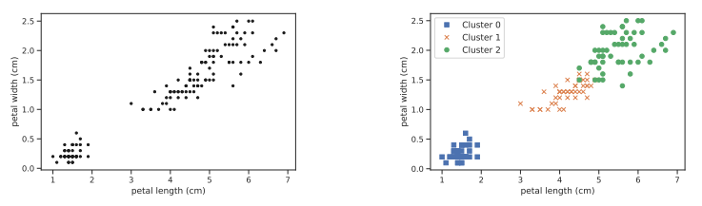
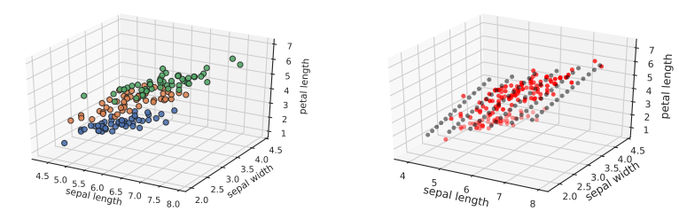
Unsupervised learning - Clustering
A simple example of unsupervised learning is the problem of finding clusters in data. The goal is to partition the input into regions that contain “similar” points.

Slide 16
Semi-supervised learning
Some algorithms can deal with partially labeled training data, usually a lot of unlabeled data and a little bit of labeled data
Enter the realm of semi supervised learning
For example, photo sharing service
Once we upload our family photos to the service, it automatically recognizes that the same person A shows up in photos 1, 5, and 11
While another person B shows up in photos 2, 5, and 7: this is the unsupervised part of the algorithm (clustering)
Now all the system needs is for you to tell it who these people are
Just one label per person, 4 and it can name everyone in every photo, which is useful for searching photos

Slide 17
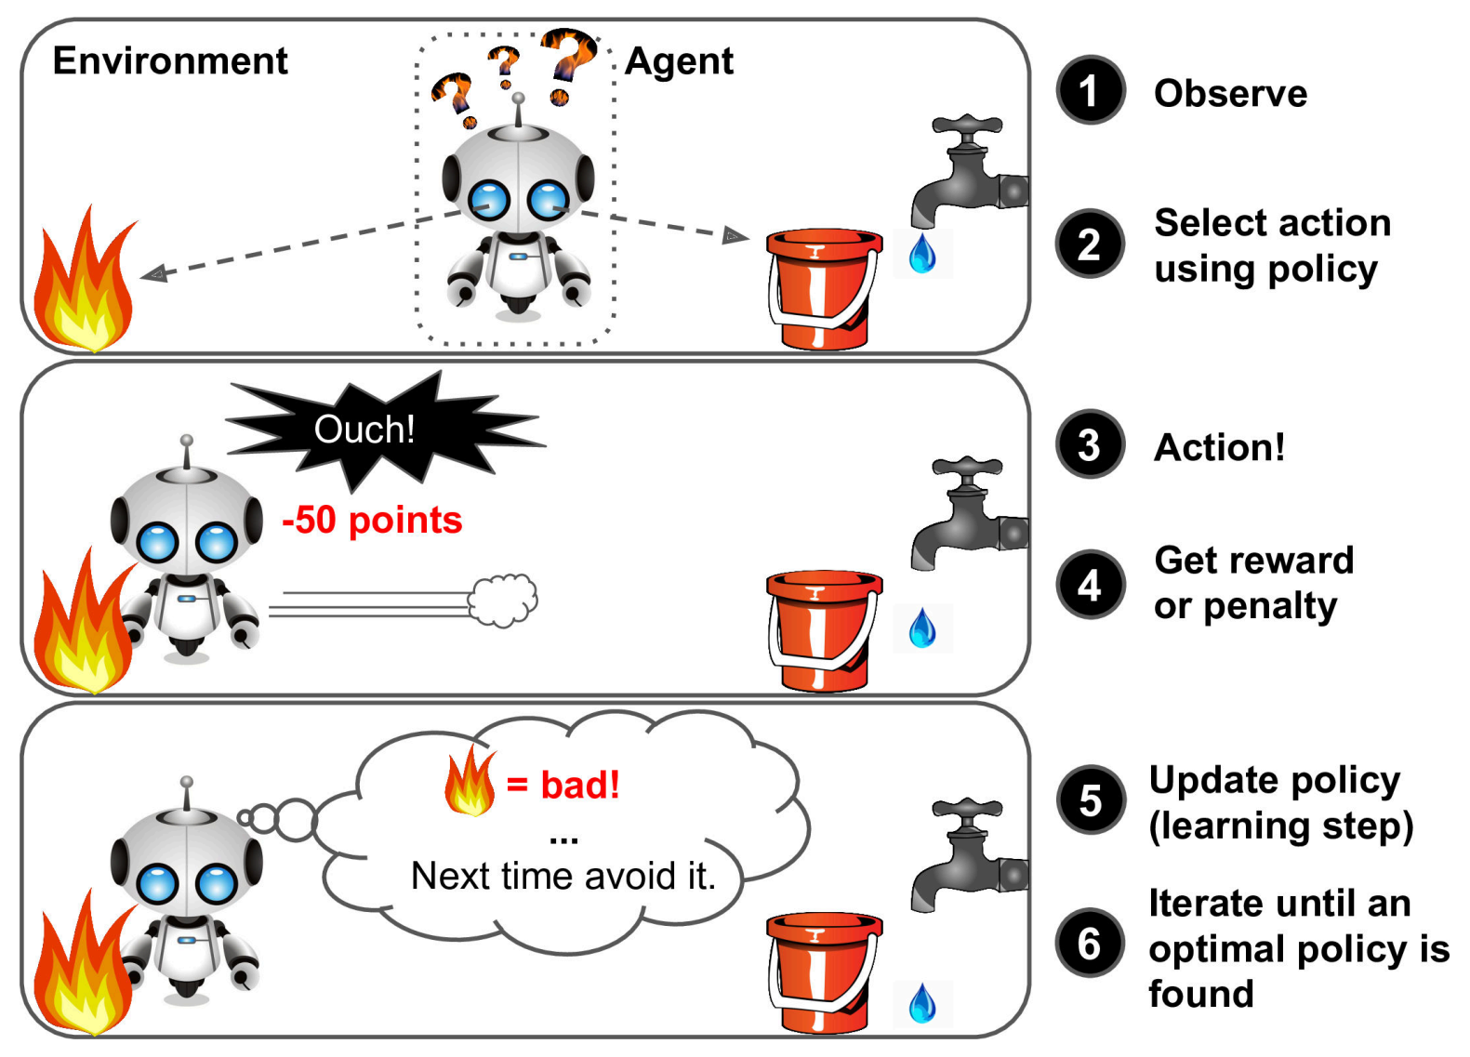
Reinforcement learning
In addition to supervised and unsupervised learning, there is a third kind of ML known as reinforcement learning (RL).
In this class of problems, the system or agent has to learn how to interact with its environment.
This can be encoded by means of a policy a = π(x), which specifies which action to take in response to each possible input x (derived from the environment state).

Slide 18
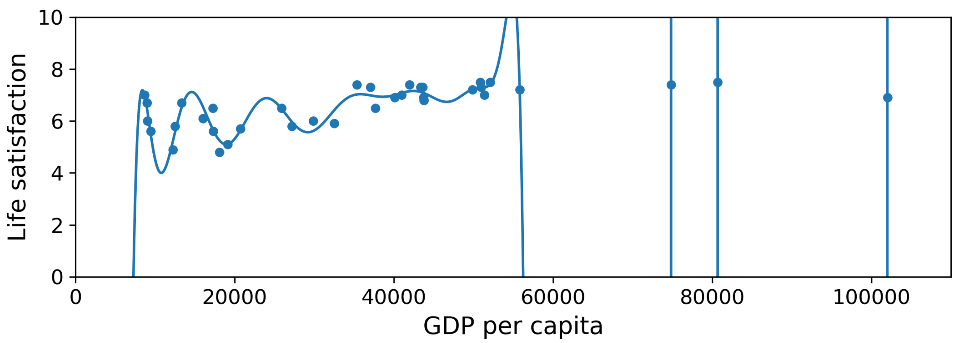
Overfitting the training data
Generalize – do not find the perfect model for the training set only

Slide 19
Underfitting the training data
Underfitting is the opposite of overfitting: it occurs when model is too simple to learn the underlying structure of the data
The main options to fix this problem are:
Selecting a more powerful model, with more parameters
Feeding better features to the learning algorithm (feature engineering)
Reducing the constraints on the model (e.g., reducing the regularization hyper‐ parameter)

Slide 20
Hyperparameter Tuning and Model Selection
Evaluating a model is simple enough: just use a test set?
How do we choose one of the two models?
Say between a linear model and a polynomial model
One option is to train both and compare how well they generalize using the test set
Now suppose that the linear model generalizes better, but you want to apply some regularization to avoid overfitting
The question is: how do you choose the value of the regularization hyperparameter?

